Slide 1
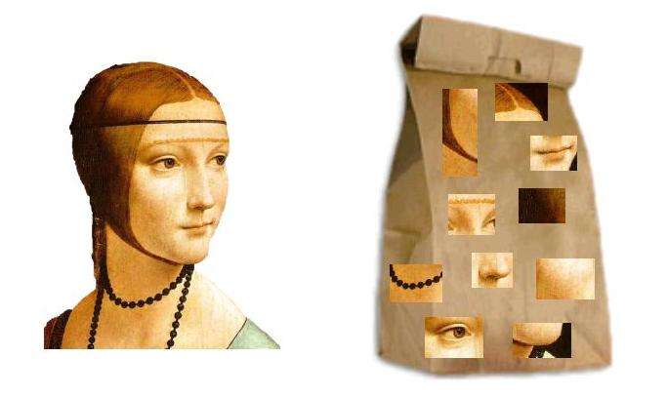
Bernhard G. Humm
Applied Artificial Intelligence
An Engineering Approach

Slide 2
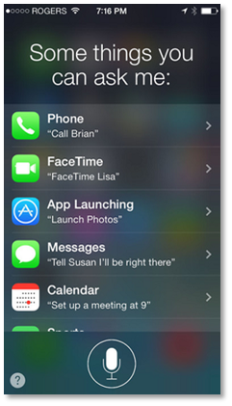

Slide 3
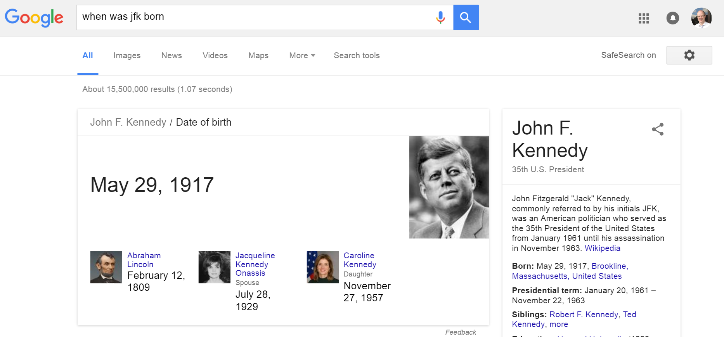

Slide 4
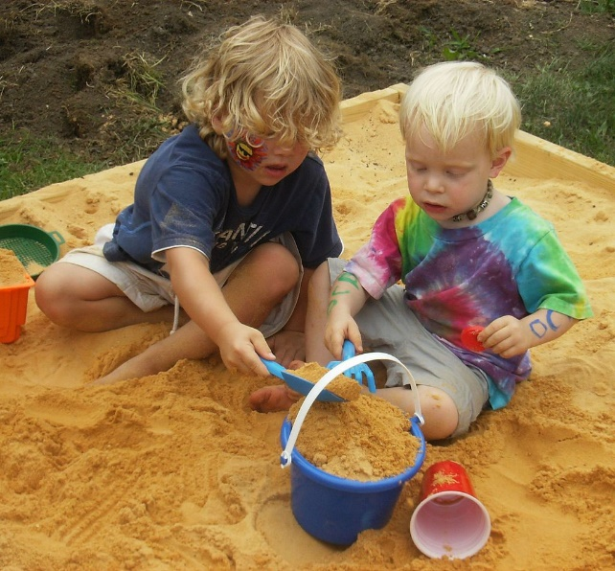
Perceiving:
Seeing, listening, feeling, …
Learning, Knowing, Reasoning: Thinking, planning, …
Communicating: Speaking, writing, …
Acting

Slide 5
Communicating
Natural language processing,
Information retrieval
Reasoning
Logic programming,
Probabilistic reasoning
Complex event processing
Applying
intelligence
Perceiving
Computer vision,
Sensor technology
Acting
Planning,
Agent technology,
Robotics
Non-symbolic
AI /
Machine
learning
Symbolic AI /
Knowledge-
based AI
Acquiring
intelligence
Semantic networks
Ontologies
Logic programming
Learning
Machine learning,
Data mining
Knowing
Knowledge representation
Artificial neural networks
Support vector machines
Linear / logistic regression
Random forest
Gradient boosting tree
K-Nearest neighors
K-means
Naive Bayes
Bayes networks
Hidden Markov models
Decision tree learning
Inductive logic programming

Slide 6
Communicating
Natural language processing,
Information retrieval
Reasoning
Logic programming,
Probabilistic reasoning
Complex event processing
Applying
intelligence
Perceiving
Computer vision,
Sensor technology
Acting
Planning,
Agent technology,
Robotics
Non-symbolic
AI /
Machine
learning
Symbolic AI /
Knowledge-
based AI
Acquiring
intelligence
Semantic networks
Ontologies
Logic programming
Learning
Machine learning,
Data mining
Knowing
Knowledge representation
Artificial neural networks
Support vector machines
Linear / logistic regression
Random forest
Gradient boosting tree
K-Nearest neighors
K-means
Naive Bayes
Bayes networks
Hidden Markov models
Decision tree learning
Inductive logic programming

Slide 8
Communicating
Natural language processing,
Information retrieval
Reasoning
Logic programming,
Probabilistic reasoning
Complex event processing
Applying
intelligence
Perceiving
Computer vision,
Sensor technology
Acting
Planning,
Agent technology,
Robotics
Non-symbolic
AI /
Machine
learning
Symbolic AI /
Knowledge-
based AI
Acquiring
intelligence
Semantic networks
Ontologies
Logic programming
Learning
Machine learning,
Data mining
Knowing
Knowledge representation
Artificial neural networks
Support vector machines
Linear / logistic regression
Random forest
Gradient boosting tree
K-Nearest neighors
K-means
Naive Bayes
Bayes networks
Hidden Markov models
Decision tree learning
Inductive logic programming

Slide 9
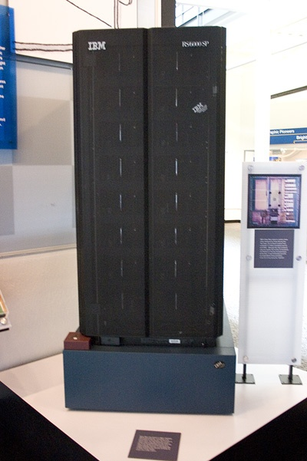
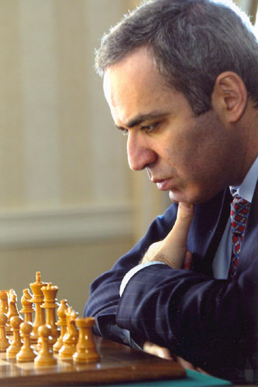

Slide 10
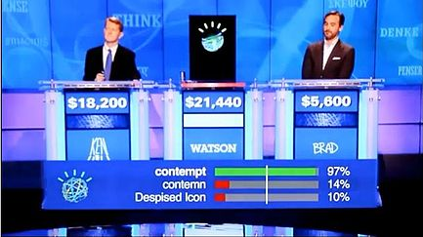

Slide 11
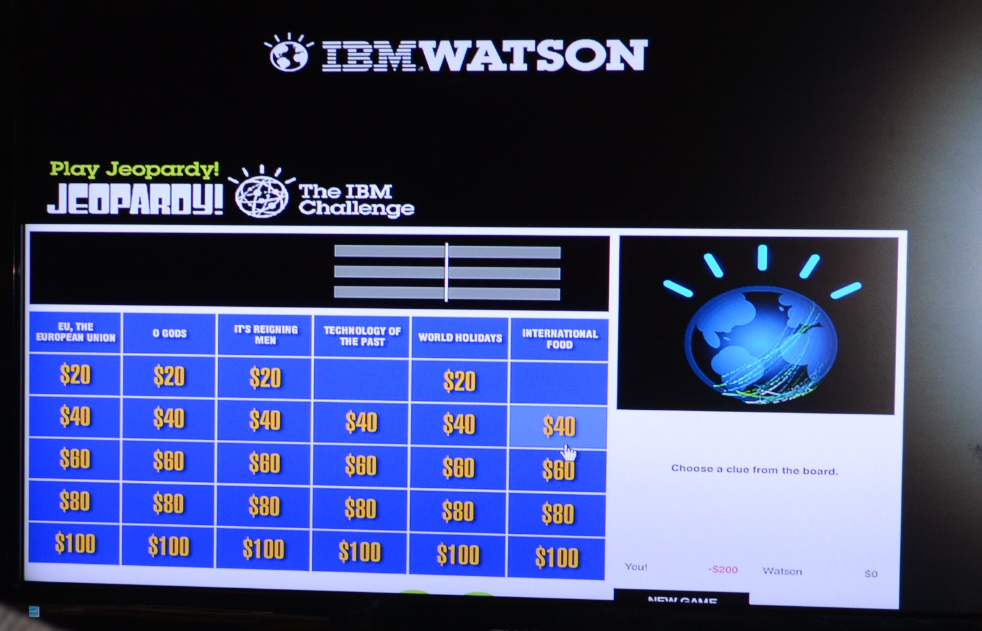

Slide 12
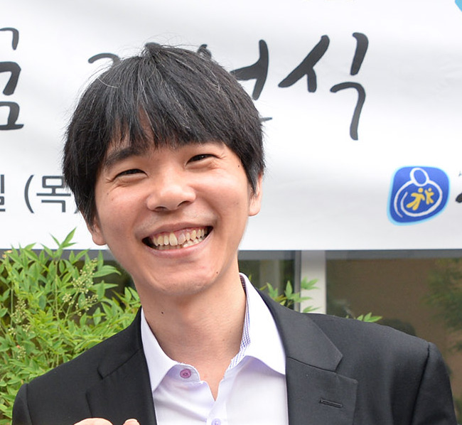
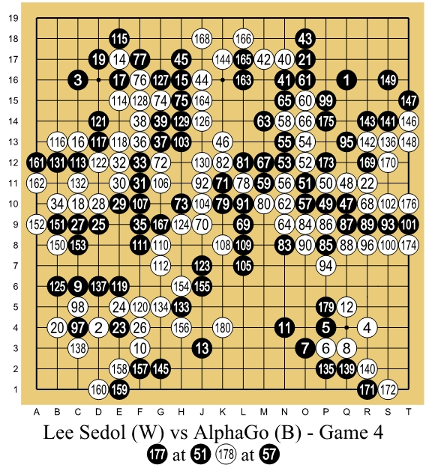
https://commons.wikimedia.org/wiki/File:Lee_Se-Dol.jpg
https://commons.wikimedia.org/wiki/File:Lee_Sedol_(B)_vs_AlphaGo_(W)_-_Game_4.jpg

Slide 13
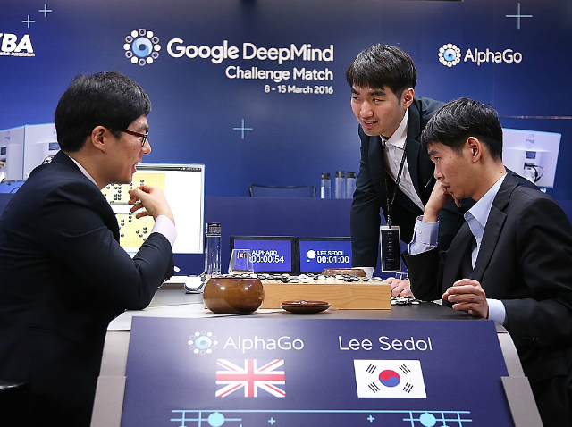

Slide 14
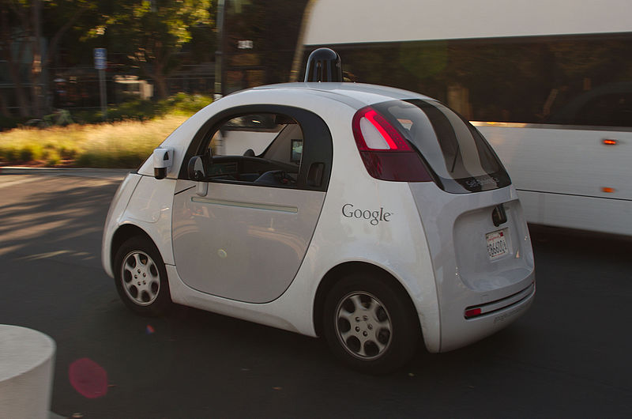

Slide 15
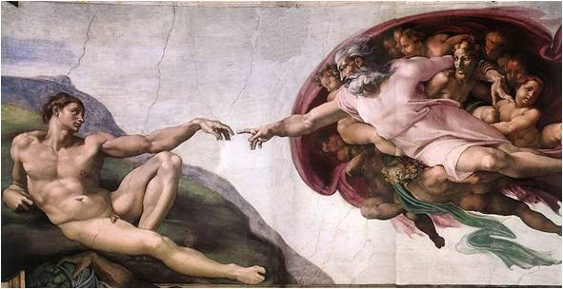

Slide 16
Michelangelo was an Italian artist.
He created many paintings, e.g., the „Creation of Adam“ in the Sistine Chapel, Rome.
He also created sculptures like David.
He belonged to the artistic movement of Renaissance.
People who create paintings are painters.
Painters are artists.

Slide 17
Ontology
Facts
Individuals
(concept instances)
Relationships
(instances)
Ontology
Ontology
Schema
Classes
(concept types)
Relationship
types
Rules

Slide 18
painted (Michelangelo, CreationOfAdam)
∀p: (∃ x: painted (p, x)) → painter (p)

Slide 19
Michelangelo
Type: Person
born: 1475
in: Italy
CreationOfAdam
type: Painting
artist:Michelangelo
…

Slide 20
Michelangelo
created
CreationOfAdam
born-in
Italy

Slide 21
(?p instance-of person)
(?p painted ?x)
-->
(?p instance-of painter)

Slide 22
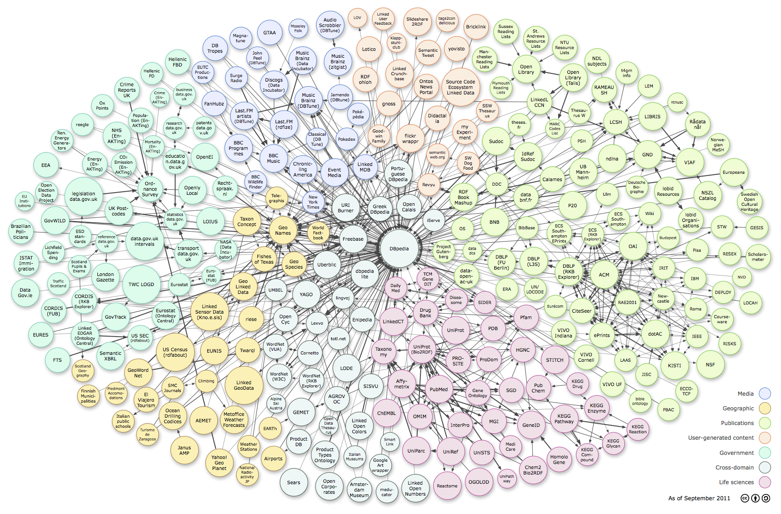

Slide 24
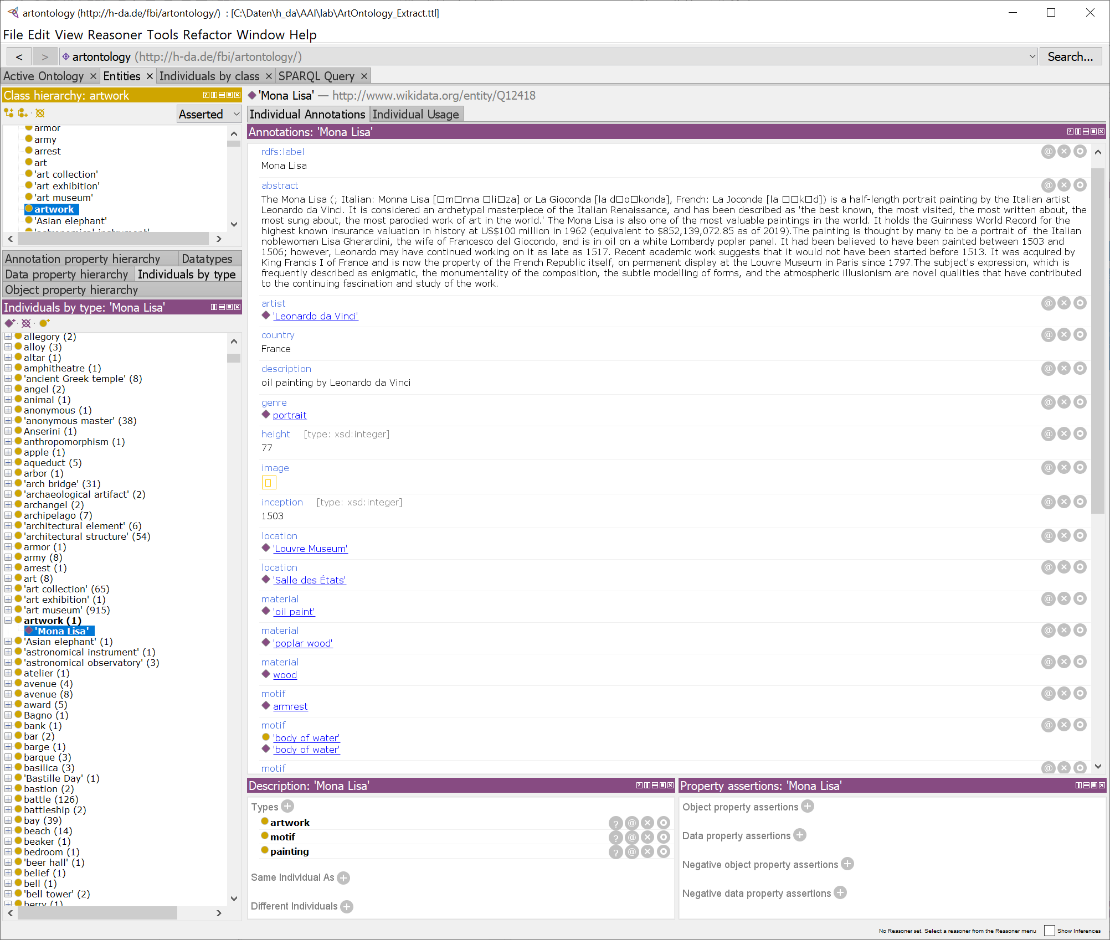

Slide 25
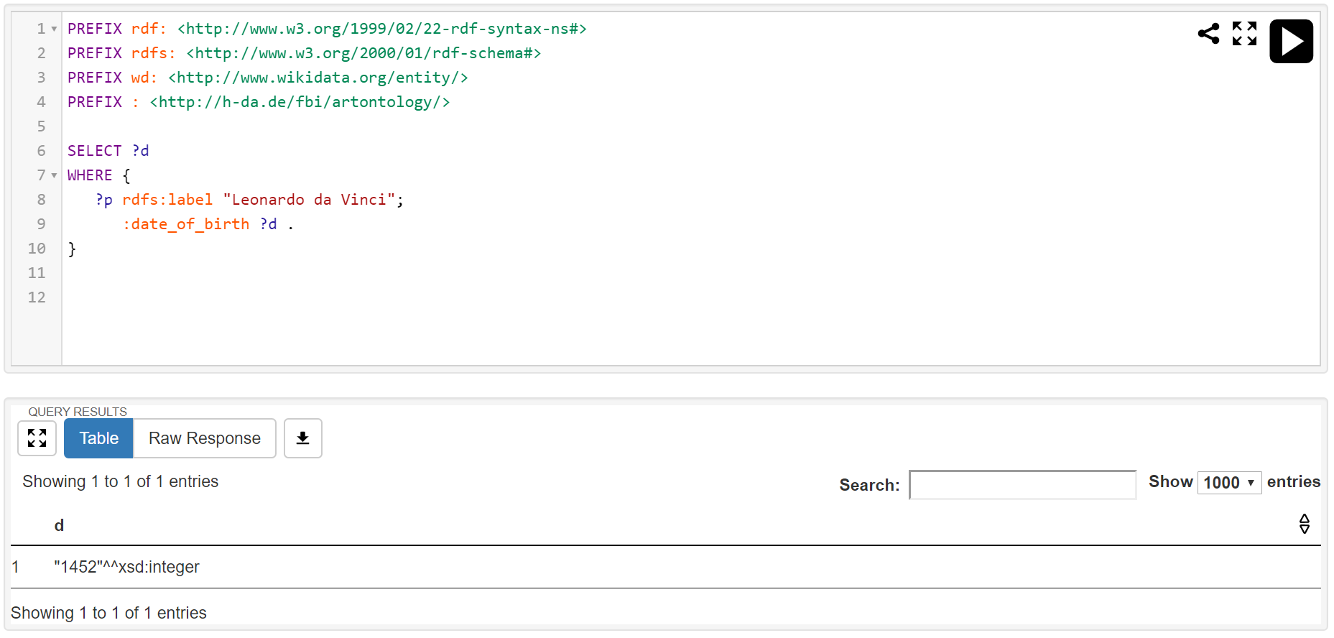

Slide 26
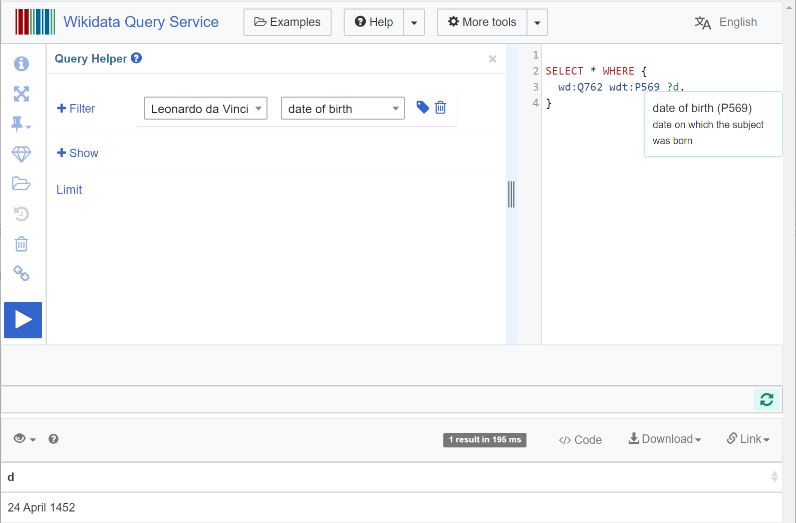

Slide 27
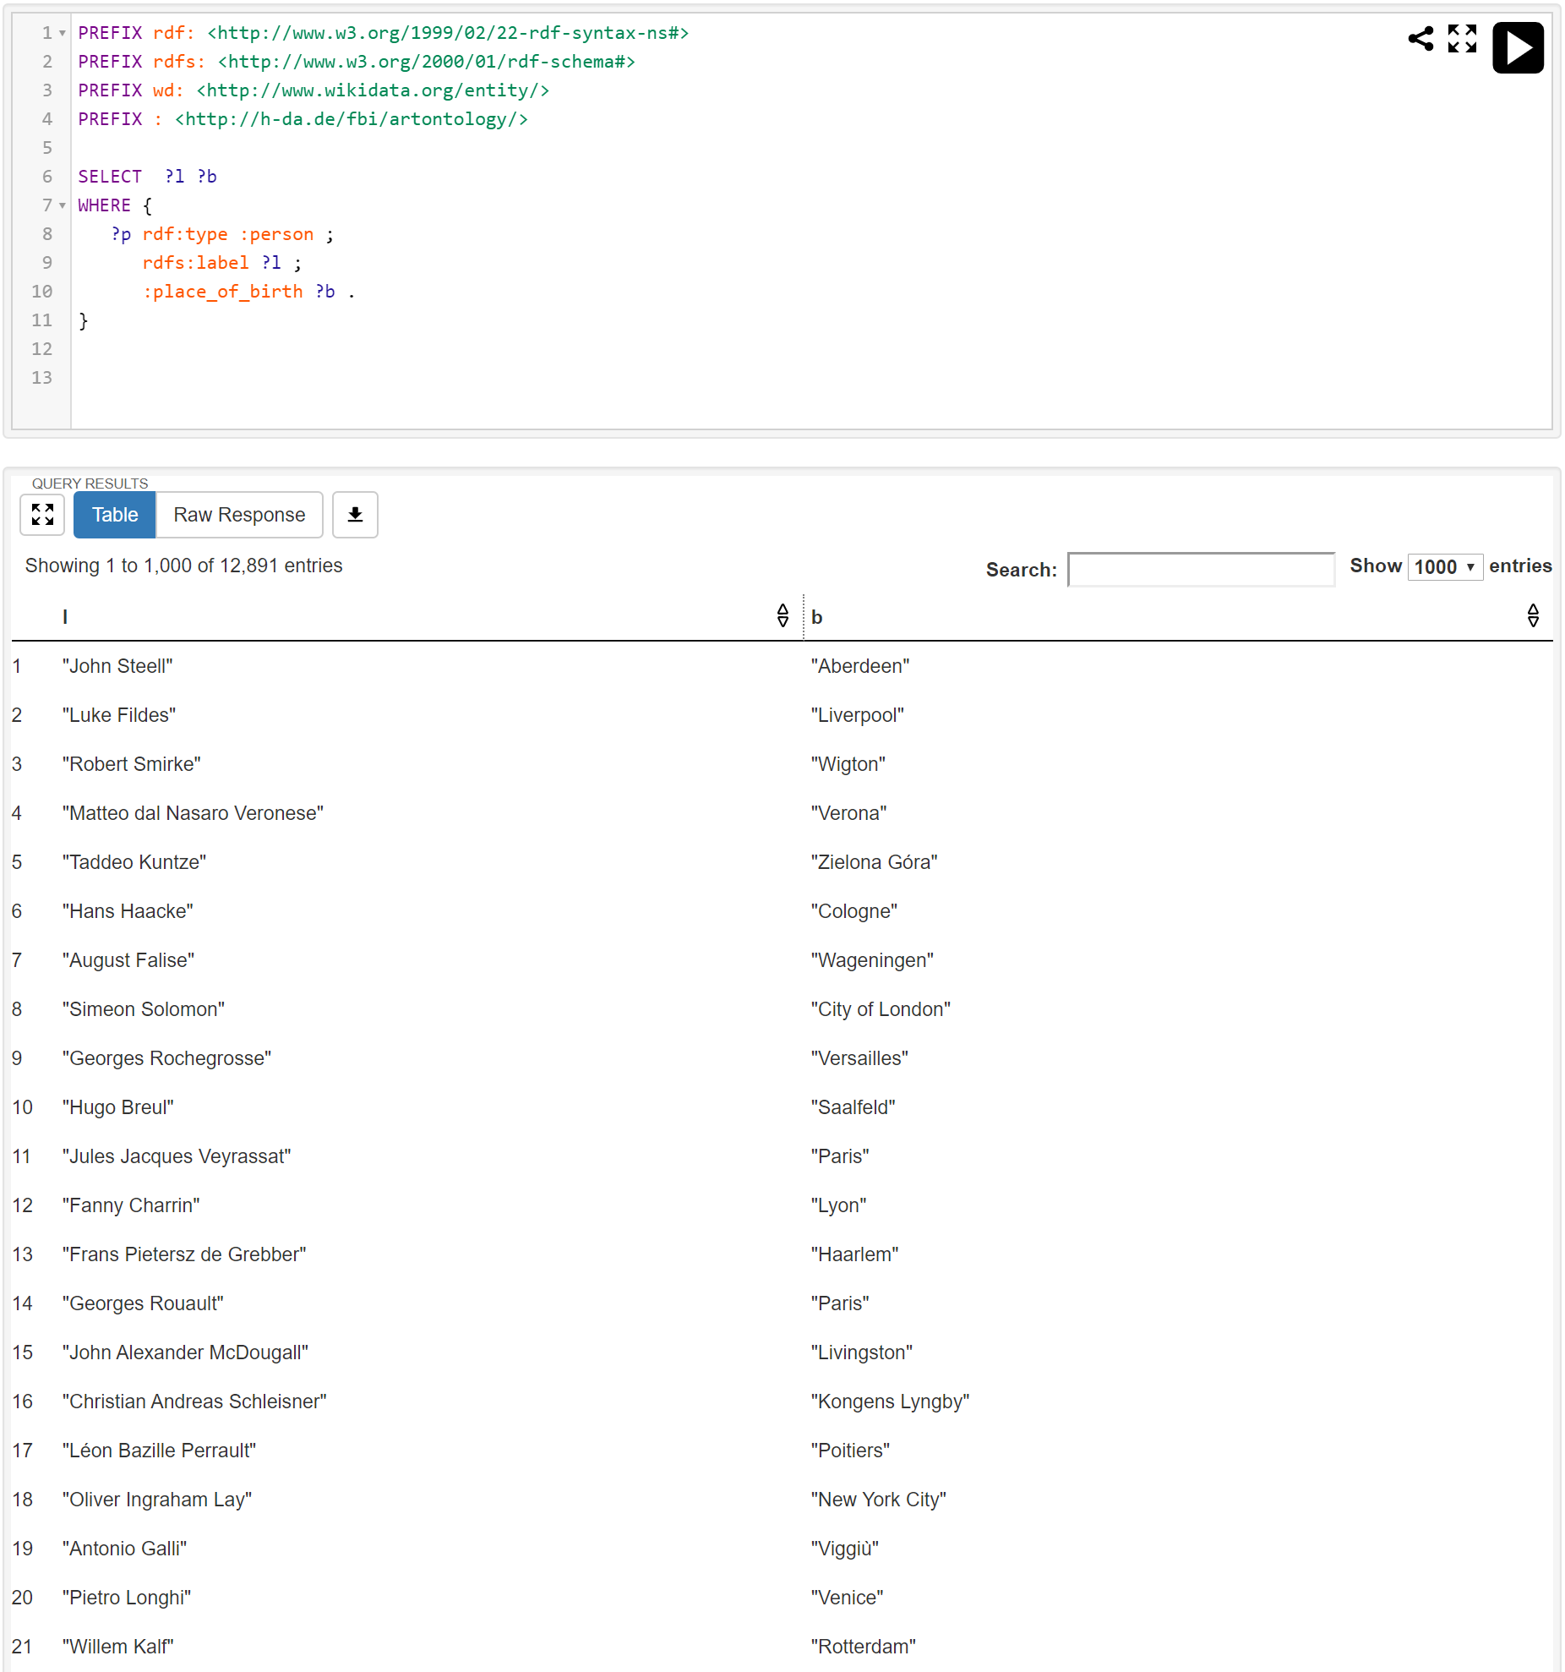

Slide 28
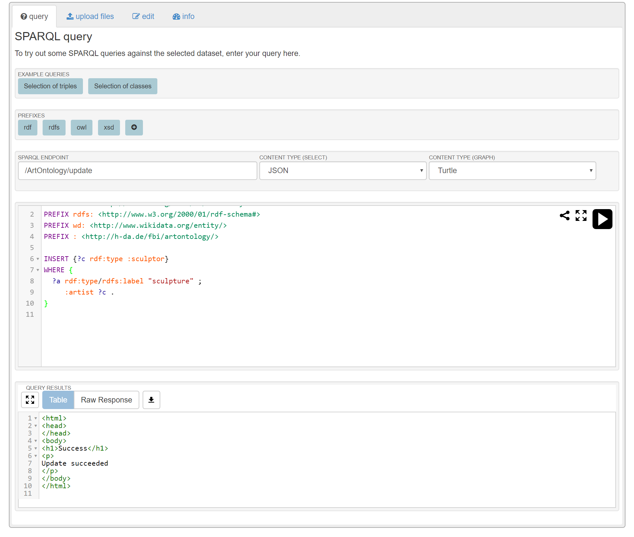

Slide 29
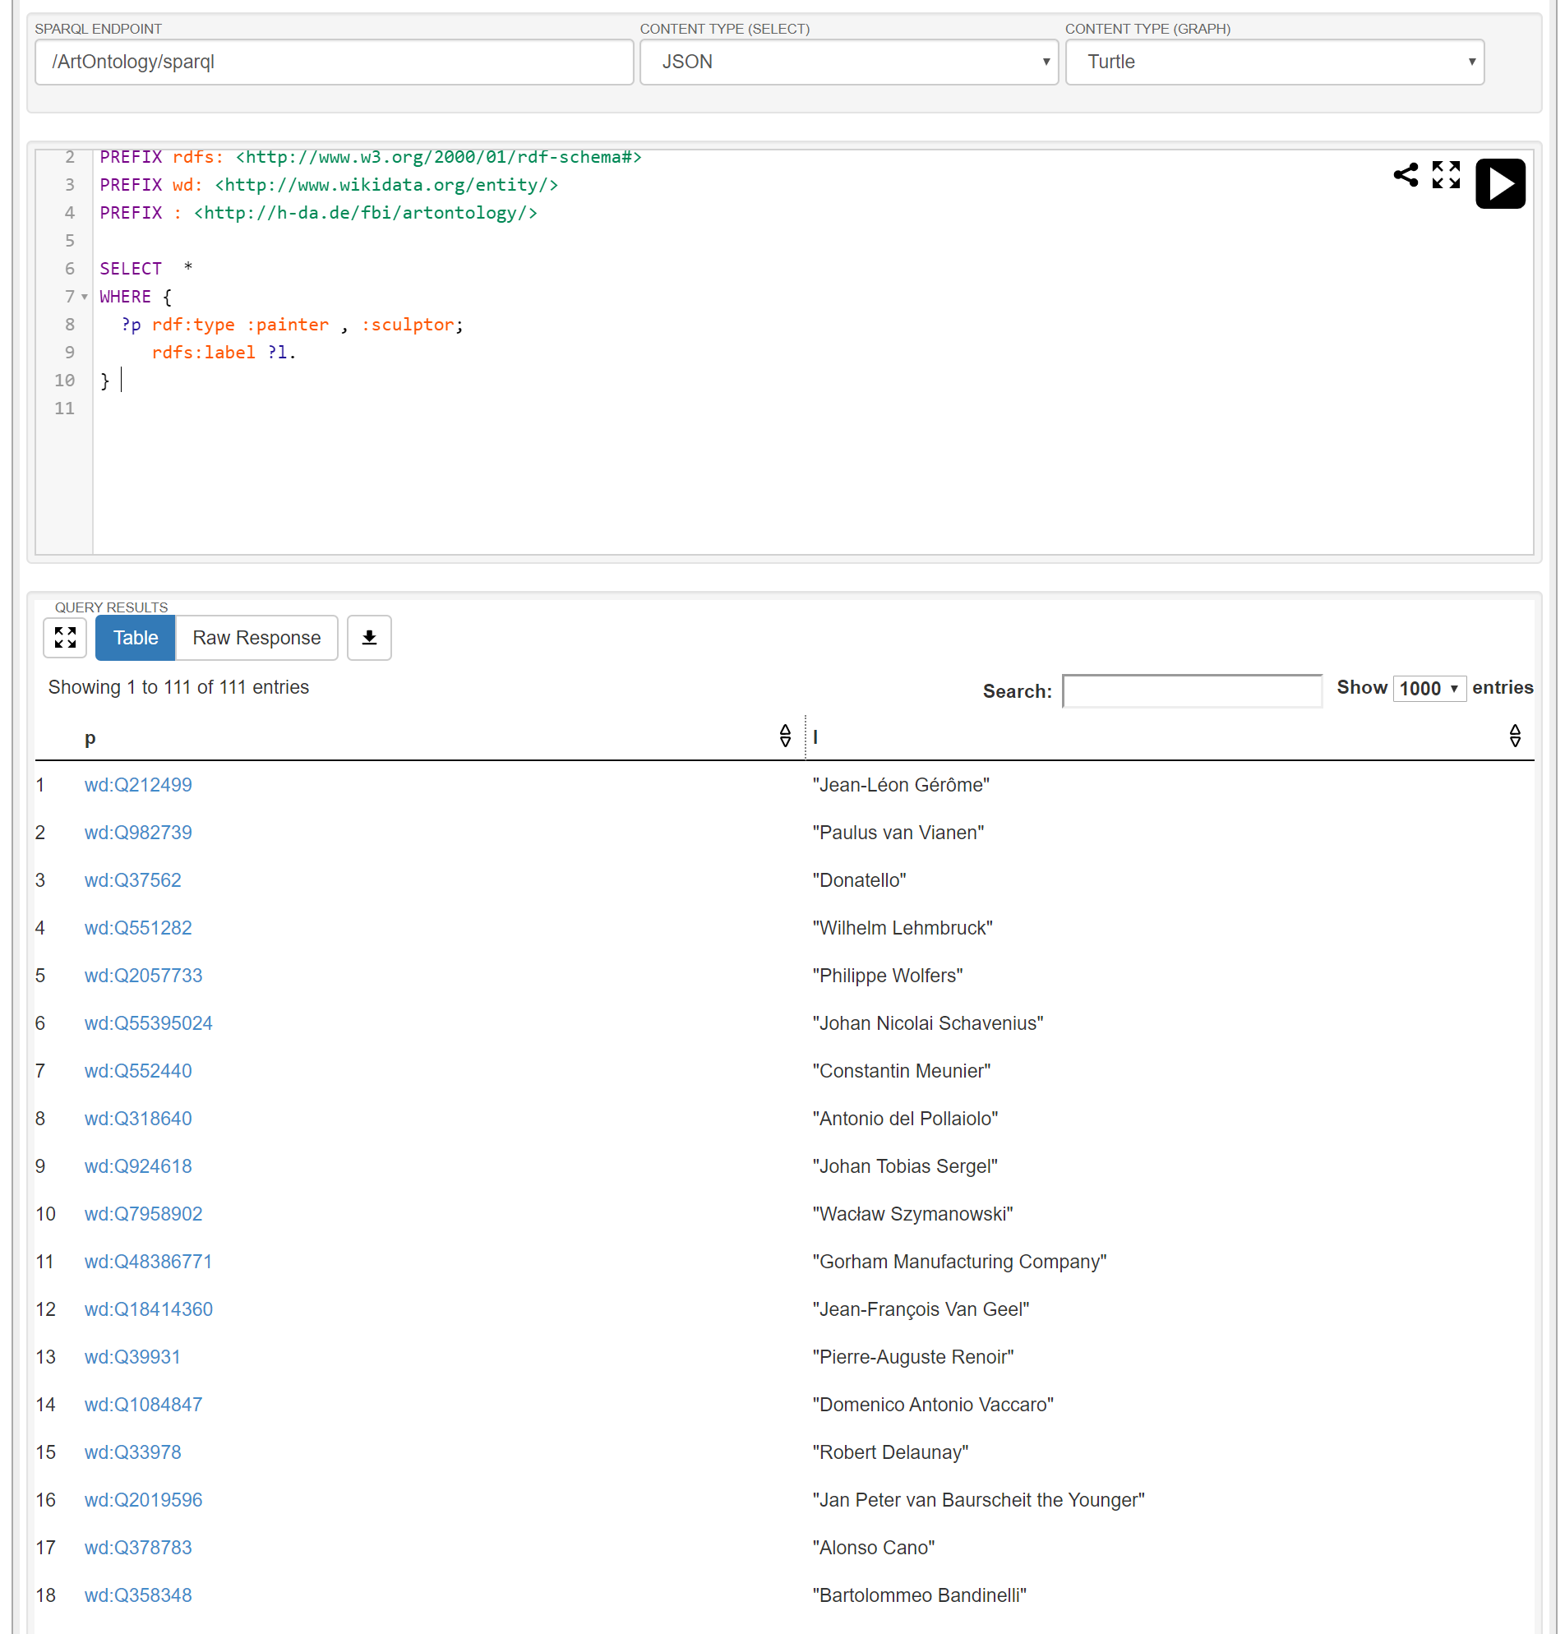

Slide 30
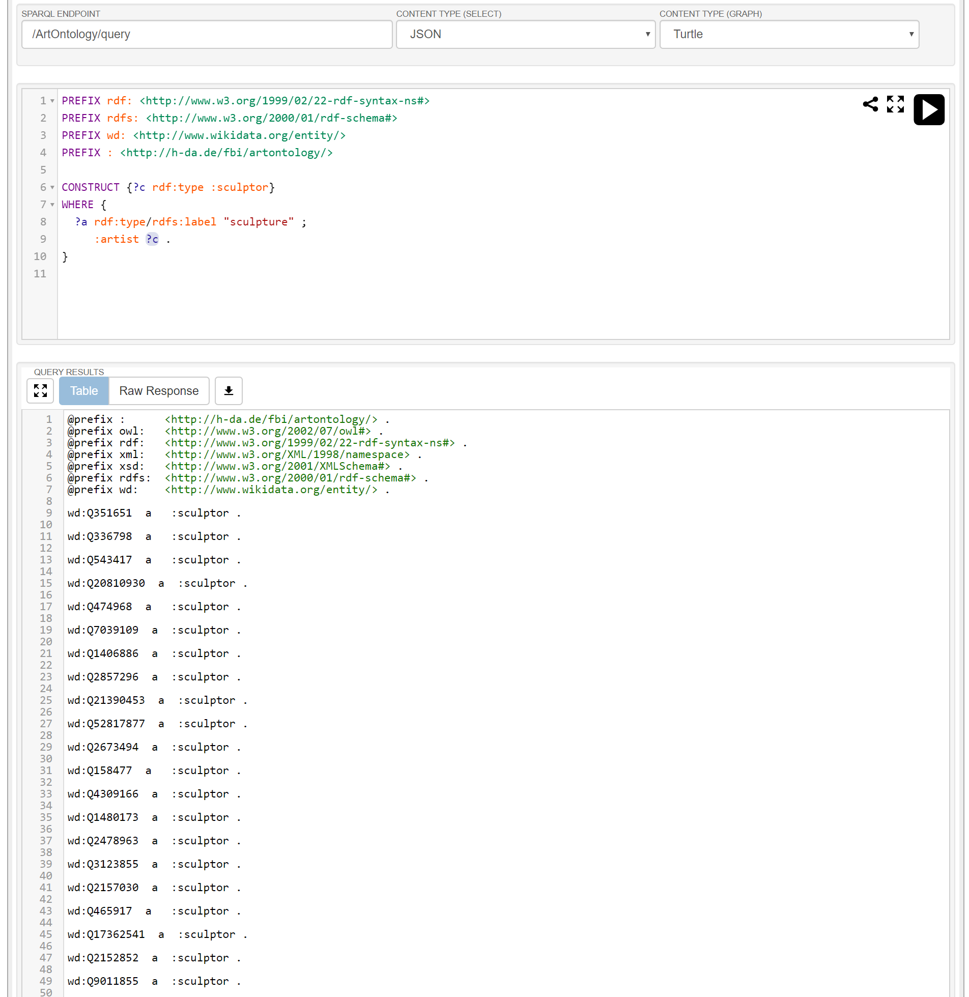

Slide 31
 | Integrated Environment | Knowledge Editor | API | Query Engine | Reasoner | Integration / Enrichment | Knowledge Base | Knowledge Resources
Protégé |  | *
Virtuoso |  |  | * | * | * |  | *
Sesame |  |  | * | * | * |  | *
Apache Jena |  |  | * | * | * |  | *
Tropbraid Suite | * | * | * | * | * | * | *
DBpedia |  |  |  |  |  |  |  | *
YAGO |  |  |  |  |  |  |  | *

Slide 32
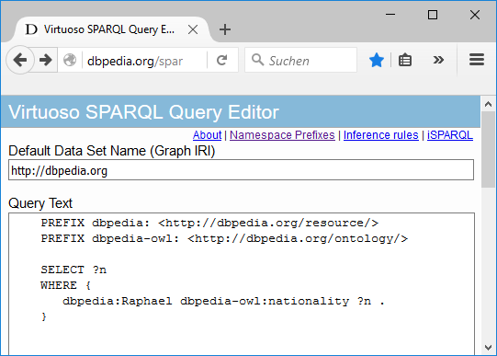
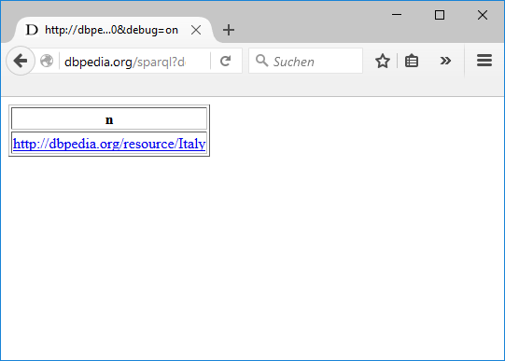

Slide 33
Namespace | Description | URI
rdf: | Resource Description Framework | http://www.w3.org/1999/02/22-rdf-syntax-ns#
rdfs: | RDF Schema | http://www.w3.org/2000/01/rdf-schema#
owl: | Web Ontology Language | http://www.w3.org/2002/07/owl#
xsd: | XML Schema | http://www.w3.org/2001/XMLSchema#
dbpedia: | Dbpedia Resource | <http://dbpedia.org/resource/>
dbpedia-owl | Dbpedia Ontology | <http://dbpedia.org/ontology/>
dbpprop | Dbpedia Property | <http://dbpedia.org/property/>
yago | YAGO Ontology | <http://dbpedia.org/class/yago/>

Slide 34
rdfs:label
"Michelangelo"
wd:Q5592
:date_of_birth
1475
…
:movement
wd:Q1474884

Slide 35
Integrated Environment
Product bundle for many knowledge representation services
KB access via programming language
Off-the-shelf ontologies
API
Knowledge Resources
Knowledge Editor
Query Engine
Reasoner
Data Integration /
Semantic Enrichment
Knowledge Base
Editing ontologies
Storing ontologies
Inferencing
Integrating knowledge resources

Slide 36












Integrated Environment
Topbraid Suite, PoolParty Semantic Suite, Semafora, …
Virtuoso, GraphDB, AllegroGraph, rdf4J, Jena, …
API
Knowledge Resources
Knowledge Editor
Query Engine
Reasoner
Data Integration /
Semantic Enrichment
Knowledge Base
Protégé, Topbraid Composer, …
Fuseki,..
Pellet, FaCT++, HermiT,..
Wikidata, Dbpedia, YAGO, CYC, GND, …

Slide 37
HTML/CSS, JavaScript, …
User Interface
Java, C#, Ruby, Scala, Clojure, Lisp, …
API
Application Logic / Agents
API
Jena, AllegroGraph, OWLIM, Virtuoso …
Knowledge Base / Query Engine / Reasoner
Stanbol, Any23, Nutch, Triplfy, …
Data Integration / Semantic Enrichment
Legend:
Component
Data Flow
Ontologies, Databases, Web Pages, Documents, …

Slide 38
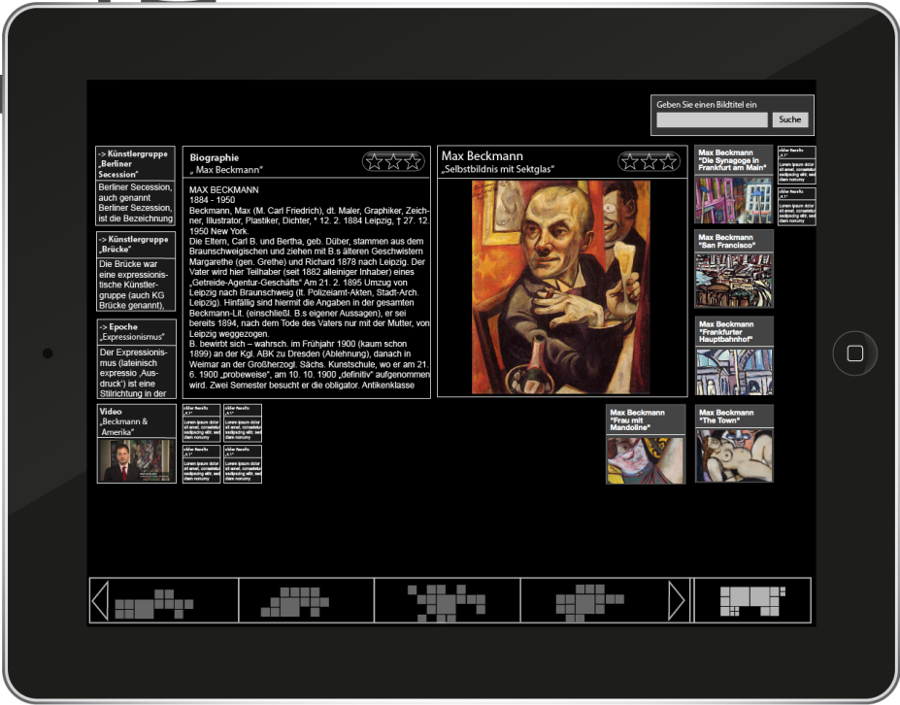
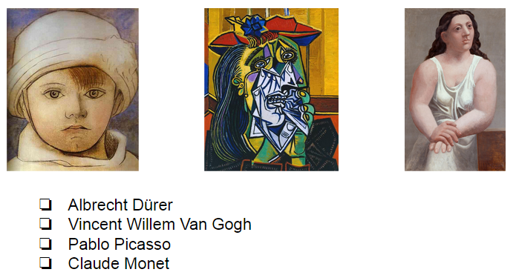

HTML/CSS, JavaScript incl. libraries
Presentation:
Virtual Museum Guide GUI
REST
API
Application Logic: Virtual Museum Guide
Java incl. libraries
Online
Arts
Model
User
Model
Story Gene-ration
NLP
API
Sesame
Knowledge Base / Query Engine
ArtsOntology.owl
Offline
SPARQL via endpoint
Extraction Scripts
DBpedia
Legend:
Component
Data Flow

Slide 39
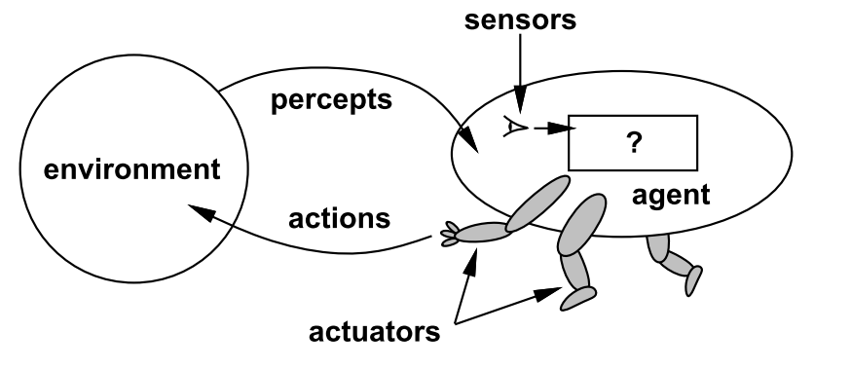

Slide 40
Agent | Environment | Percepts and Actions
Thermostat | Room and heating | Measures temperature and adjusts heating accordingly
Softbot | Internet | Crawls web pages, extracts information (e.g., compares prices), makes recommendations or even purchases autonomously
Robot | Home | Performs simple household tasks like vacuum cleaning
Human | World | Performs all sorts of things, some better, some worse for the environment ;-)

Slide 41
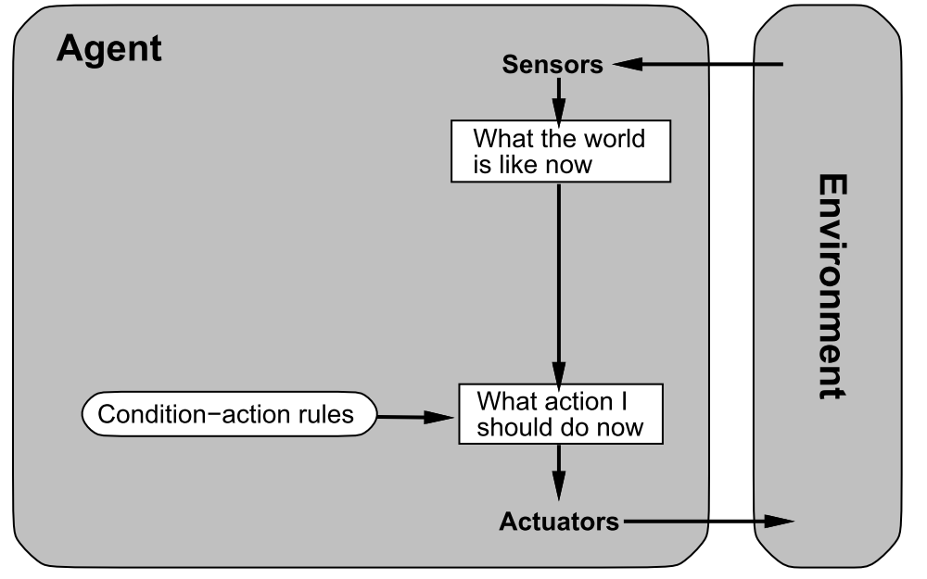

Slide 42
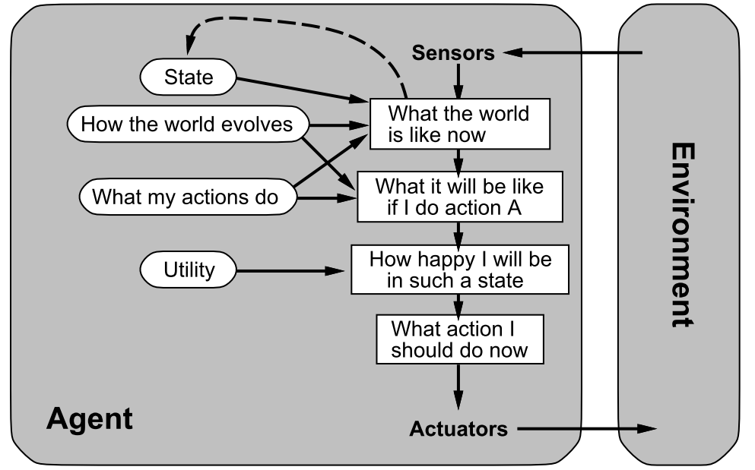

Slide 43
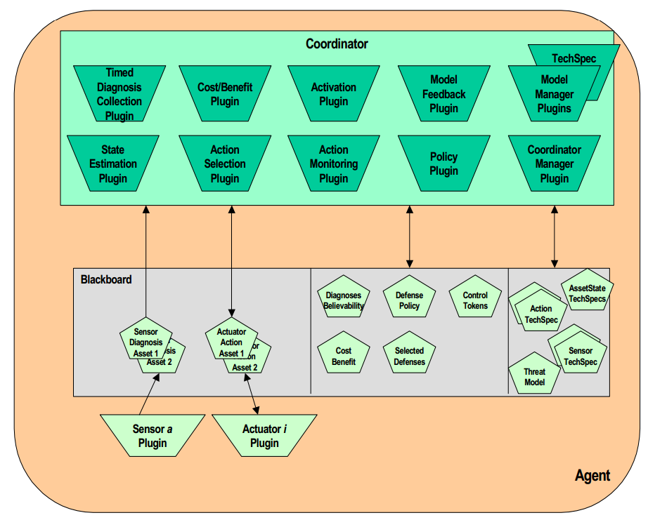

Slide 44
Search Web Service
Search Server Platform
Web service providing a complete search facility
Server platform as stand-alone search engine
Search Engine Library
Indexer
Crawler
Library and API for accessing a search index incl. ranking
Library and API for creating a search index
Library for crawling web pages

Slide 45
Search Web Service
Search Server Platform
Google, Yahoo, …
Solr, Elastic Search
Search Engine Library
Indexer
Crawler
Lucene, …
Nutch, …

Slide 46
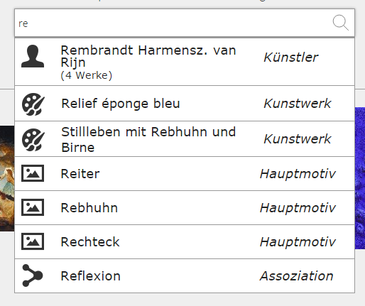

Slide 47
Consequences
inform (x, y)
Background knowledge
Pragmatic
analysis
Knowledge
eats (Billy, Lunch)
Background knowledge
Semantic
analysis
Sentences
Billy is eating lunch.
Grammar rules
Syntactic
analysis
Words
Billy …
Dictionaries
Lexical
analysis
Letters
Bil…
Language sound combinations
Phonological
analysis
Sounds
æ ç Þ ð ţ ş
Features of the voice
Phonetic
analysis
Acoustic
Signals
Information needed for processing
NLP processing step
Information level
Example

Slide 48
My
dog
also
likes
eating
sausage
.

Slide 49
My
dog
also
likes
eating
sausage
.

Slide 50
My
dog
also
likes
eating
sausage
.
PRP$
NN
RB
VBZ
VBG
NN
.
Possessive pronoun
Noun, singular
Verb, 3rd person singular present
Verb, gerund or present participle
Adverb
Noun, singular
Full stop (period)

Slide 51
sentence
adverb phrase
ROOT
noun phrase
verb phrase
S
NP
ADVP
VP
S
VP
NP
My
dog
also
likes
eating
sausage
.
PRP$
NN
RB
VBZ
VBG
NN
.

Slide 52
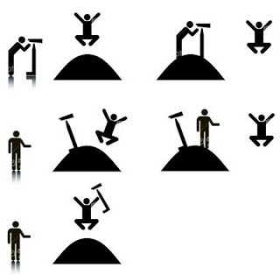
I saw the man. The man was on the hill. I was using a telescope.
I saw the man. I was on the hill. I was using a telescope.
I saw the man. The man was on the hill. The hill had a telescope.
I saw the man. I was on the hill. The hill had a telescope.
I saw the man. The man was on the hill. I saw that he was using a telescope.

Slide 53
NLP web services
NLP frameworks
Machine translation, NER, sentiment analysis, …
Frameworks for integrating NLP building blocks (pipeline-based)
NLP building blocks
Language resources
tokenizing, POS tagging, parsing, …
Language data sets: dictionaries, thesauri, synonyms, …

Slide 54
NLP web services
NLP frameworks
Google Translate, NERD, AlchemyAPI, …
UIMA, GATE, …
NLP building blocks
NLP resources
Stanford Tokenizer, POS Tagger, Parser, …
WordNet, GermaNet, …

Slide 55
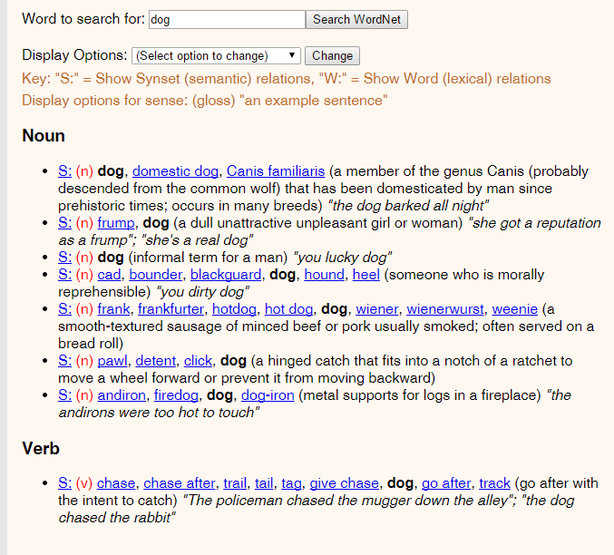

Slide 56
Animal
Broader (hypernym)
Mammal
Synonym
Dog
Canis familiaris
Narrower (hyponym)
Puppy
Hunting dog
Dalmatian
Poodle
…

Slide 57
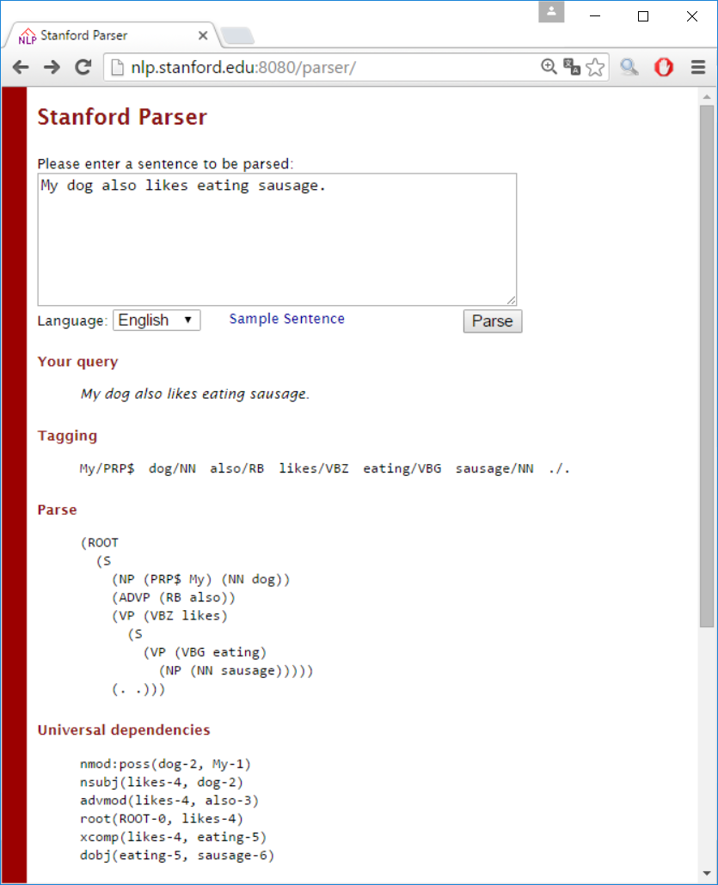

Slide 58
Specifies common data formats
Plugin architecture
Allows pipeline configuration
Perform NLP tasks
3rd party products (e.g., Stanford parser)
UIMA pipelining framework
NLP building blocks (components)
Tokenizer
Sentence Splitter
POS Tagger
Parser
…
Language
resources
Dictionary
Named Entitites
…
Provide NLP data
3rd party products (e.g., WordNet)

Slide 59
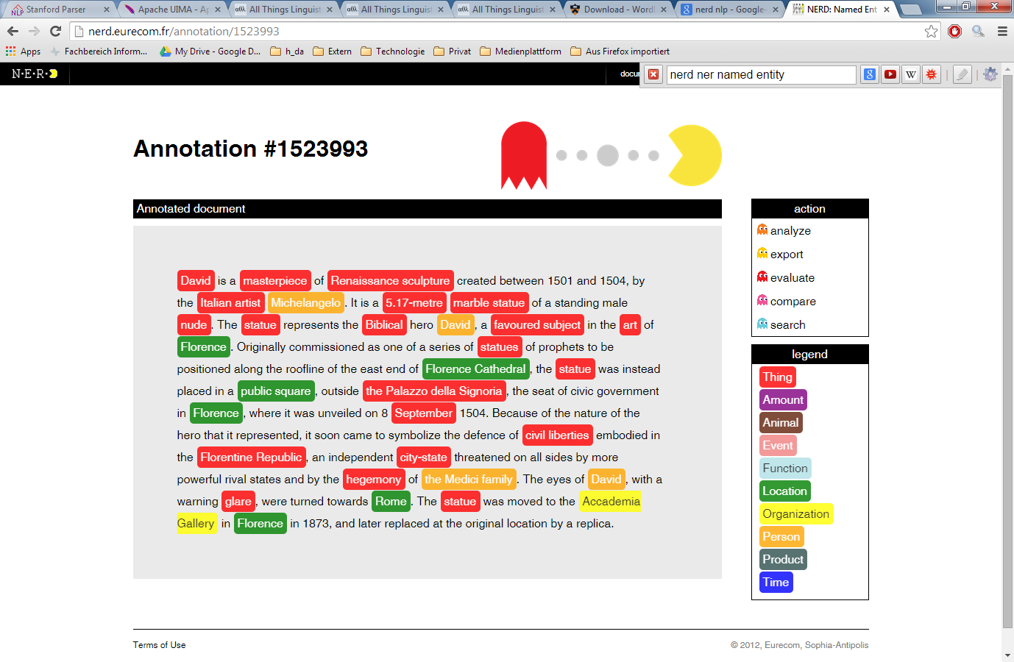

Slide 60

New emails
Automatically
classified
Not
spam
Spam filter
Spam
Training input
Corrections
Manually
classified
samples

Slide 61
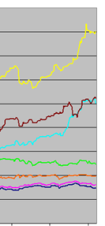

Current share values
Prediction
Recommendation
Training input
Decision
History of
share values

Slide 62
Automatically
classified
No
fraud
Fraud detection
Fraud
Training input
Corrections
Manually
classified
samples

Slide 63
Order
Recommendation
of related products
Recommender system
Training input
Purchasing behaviour
of other customers
or customer groups

Slide 64
Machine Learning
Supervised Learning
Unsupervised Learning
Reinforcement Learning
ML Area
Classifi-cation
Regression
Clustering
Feature selection / extraction
Topic modeling
ML Task

Slide 65
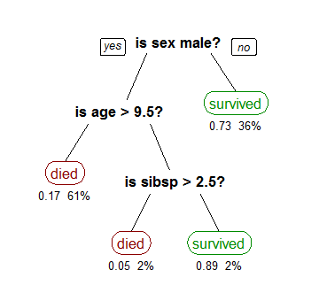

Slide 66
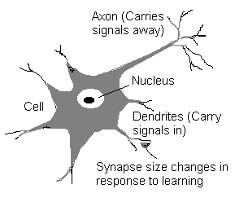

Slide 67
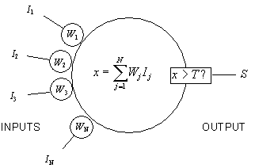

Slide 68
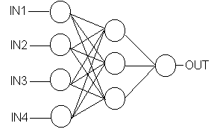

Slide 69
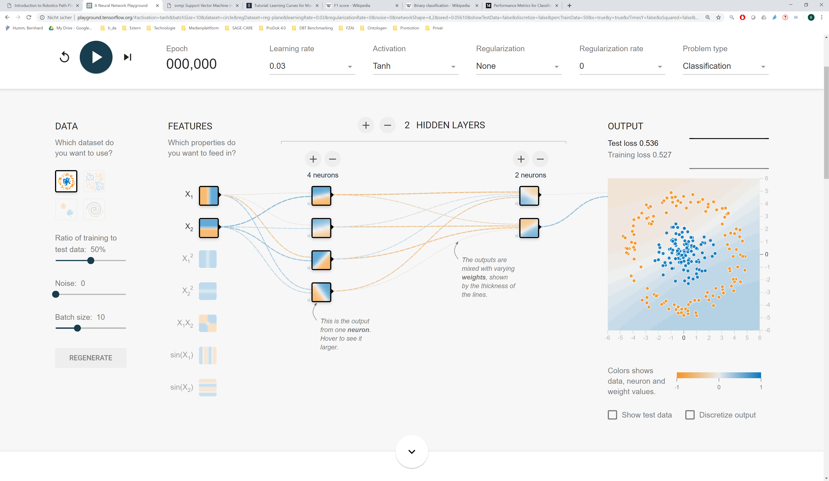
http://playground.tensorflow.org

Slide 70
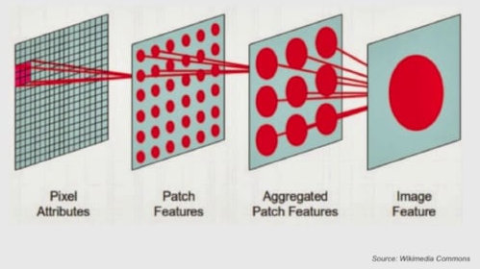

Slide 71
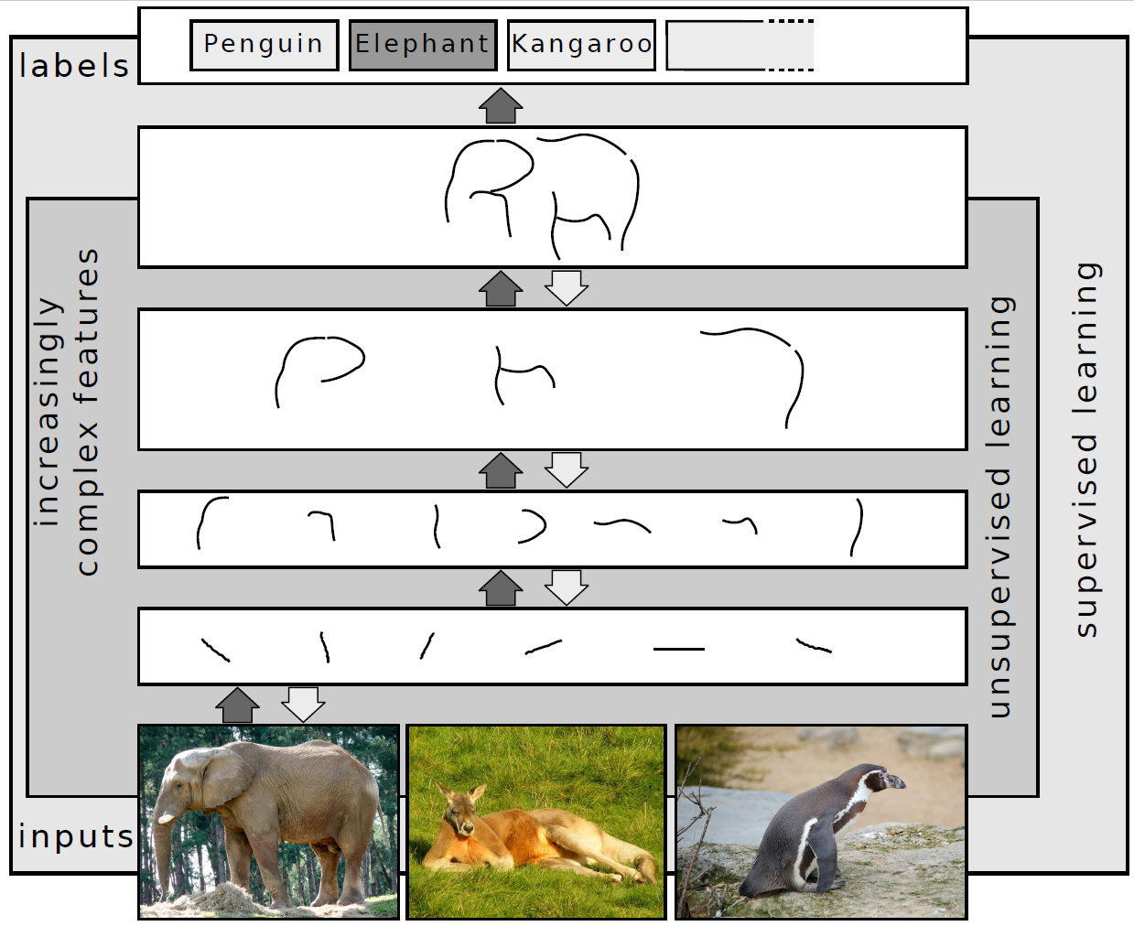

Slide 72
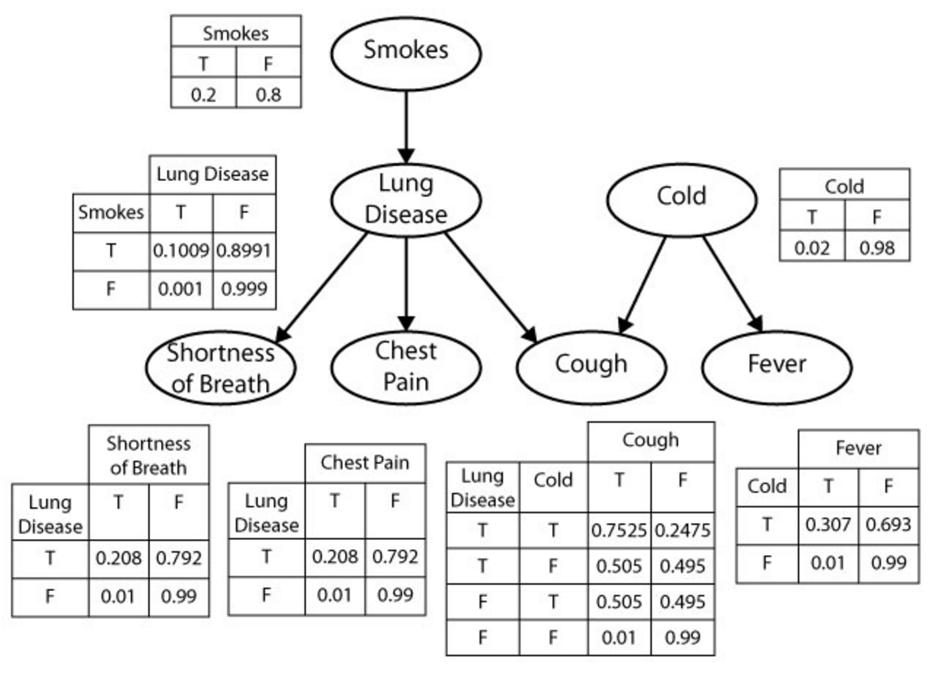

Slide 73
George
Helen
parent
Mary
Tom
Nancy
Eve

Slide 74
Classification
Regression
Artificial Neural Network (ANN)
Decision Tree
Random Forest
Gradient Boosting Tree
Logistic Regression
Linear Regression
Support Vector Machine (SVM)
Unsupervised ML Supervised ML
k-Nearest Neighbors (k-NN)
Naive Bayes
Clustering
Feature reduction
k-means Clustering
Principal Component Analysis (PCA)
Hierarchical Clustering
Singular Value Decomposition (SVD)
Canonical Correlation Analysis

Slide 75
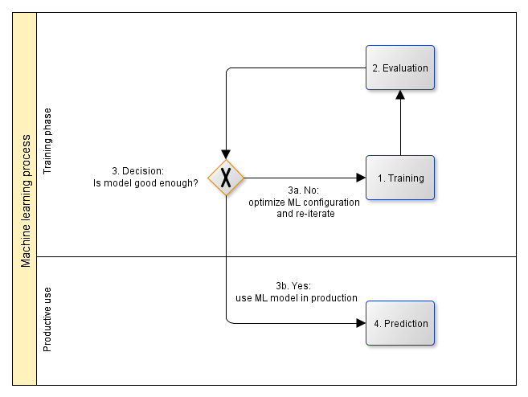

Slide 76
Evaluation
Test data set
ML application
ML result
Evaluation
ML prediction performance
Training
Split data set
Training data set
Training
ML model
Training improvement
Corrected result
Raw data set
Pre-processing
ML configuration
If model is
good enough
Prediction in productive use
Production data
ML application
ML result
Manual validation
Legend:
Data
Data Flow
Process step
Optional
process step

Slide 77
Machine learning web services
Machine learning development environments /
frameworks
Web services for experimenting with different ML approaches and configuring solutions
IDEs and frameworks for experimenting with different ML approaches and configuring solutions
Machine learning libraries
Algorithms for classification, regression, clustering, feature selection / extraction, topic modeling, etc. using different approaches, e.g., decision tree learning, artificial neural networks, Bayes networks, inductive logic programming, support vector machines, hidden Markov chains, etc.

Slide 78
Machine learning web services
Machine learning development environments /
frameworks
Google Prediction API, Microsoft Azure Machine Learning, bigml, wise.io, procog, ersatz, …
SPSS Modeler, RapidMiner, WEKA, Orange, Shogun, scikt-learn, …
Machine learning libraries
TensorFlow, DL4J, Torch, Caffeee, Theano, Eblearn, OpenNN, aisolver, CURRENNT, …

Slide 79
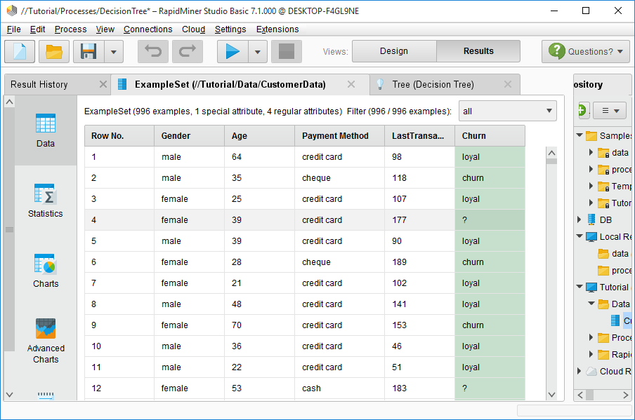

Slide 80
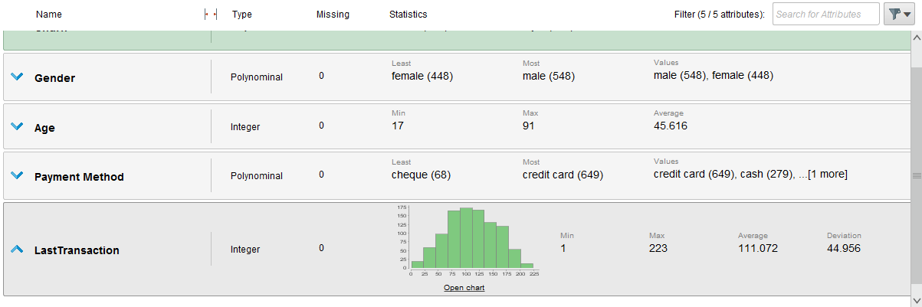

Slide 81
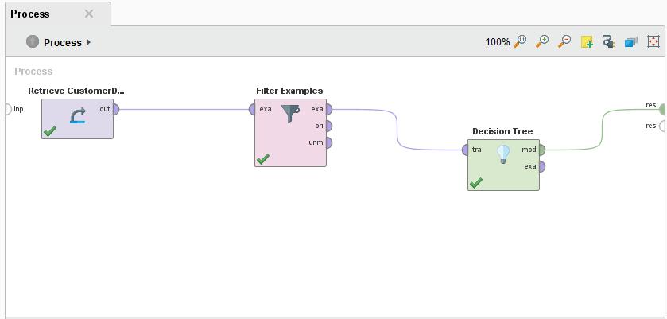

Slide 82
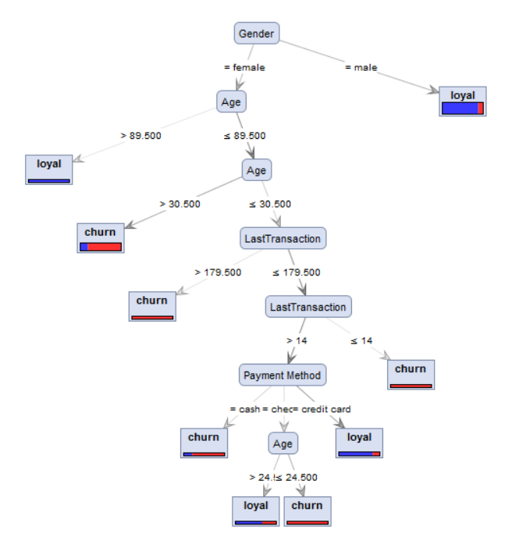

Slide 83
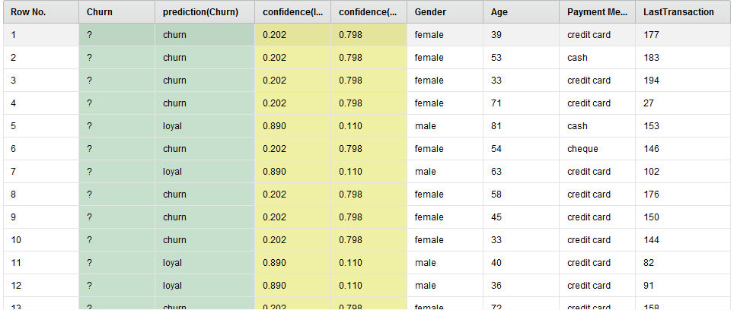

Slide 84
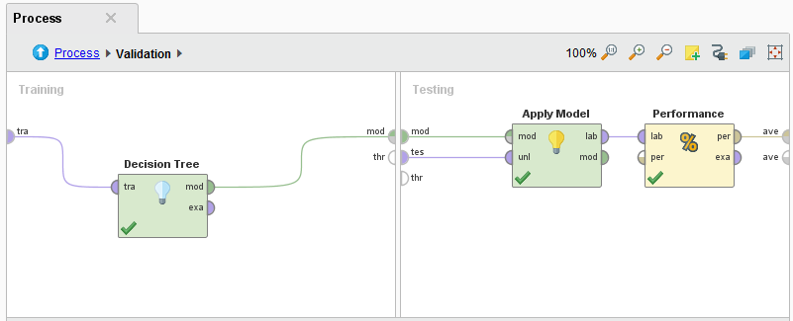

Slide 85


Slide 86


Slide 87

Actually positive
Predicted positive

Slide 88
Actual Values
Positive
(1)
Negative
(0)
Positive
(1)
True Positives (TP)
False Positives (FP)
Predicted Values
Negative
(0)
False Negatives (FN)
True Negatives (TN)

Slide 89
Actually positive
Actual Values
Positive
(1)
Negative
(0)
True Positives (TP)
False Positives (FP)
Positive
(1)
Predicted Values
Negative
(0)
False Negatives (FN)
True Negatives (TN)
Predicted positive

Slide 90
Actual Values
Malignant
Benign
Malignant
TP = 1
FP = 1
Predicted Values
Benign
FN = 8
TN = 90

Slide 91

y
x

Slide 92

k Folds
1
2
3
4
k=5
Test set
Training set
1st
→ Performance₁
2nd
→ Performance₂
k Iterations
$$Performance=\frac{1}{k} \sum_{i=1}^{k}{{Performance}_{i}}$$
3rd
→ Performance₃
4th
→ Performance₄
k=5th
→ Performance_{k}

Slide 93
y
x

Slide 94
y
x

Slide 95
y
x

Slide 96
y
x

Slide 97
y
y
y
y
x
x
x
x

Slide 98
y
x

Slide 99
y
y
y
x
x
x
(a)
(b)
(c)

Slide 100
Underfitting Optimal model complexity Overfitting
low Bias, variance, error high
low Model complexity high

Slide 101



Underfitting Optimal model complexity Overfitting
low Bias², variance, error high
Bias²
Variance
Error
low Model complexity high

Slide 102
low (good) Error high (bad)
low Training set size high

Slide 103
low (good) Error high (bad)
low Training set size high

Slide 104
The curves have already converged →
No need for adding more training instances
low (good) Error high (bad)
low Training set size high

Slide 105
The test curve could further converge to the training curve
→ Add more training instances
low (good) Error high (bad)
low Training set size high

Slide 106
Test set error
low (good) Error high (bad)
low (good) Error high (bad)
Training set error
low Training set size high
low Training set size high
(a) (b)

Slide 107
The test curve could further converge to the training curve
→ Add more training instances
The curves have already converged →
No need for adding more training instances
Test set error
Test set error
low (good) Error high (bad)
low (good) Error high (bad)
Training set error
Training set error
low Training set size high
low Training set size high
(a) (b)

Slide 108
1
Training set performance
(bad) Accuracy (good)
Test set performance
0
low Training set size high

Slide 109
Model complexity
High
(Overfitting)
Low
(Underfitting)
Number of features (attributes)
Low
High
Number of ANN layers
Low
High
Artificial
Neural Networks
Number of neurons per ANN layer
Low
High
Maximum tree size
Low
High
Decision Trees /
Random Forest
Number of branches
Low
High

Slide 110

Correct
(in reality)
Predicted
(by machine learning)
✖
✖
True negative (correctly not predicted)
False negative (correct but not predicted)
True positive (correctly predicted)
False positive (predicted but not correct)

Slide 111


Slide 112


Slide 113


Slide 114




Identify relevant services
Identify product candidates
Select product(s)
Integrate product(s)

Slide 115
ML web services
Pre-trained ML models
ML development environments
ML APIs
ML libraries

Slide 116











ML web services
ML pre-trained models
ML development environments
ML APIs
ML libraries

Slide 117



Product | Pros | Cons
Product A | … | …
Product B | … | …
Product C | … | …

Slide 118
Web services for experimenting with different ML approaches and configuring solutions
ML web services
Pre-trained ML models
IDEs for experimenting with different ML approaches and configuring solutions
Pre-trained ML models that can be fine-tuned for new applications
ML development environments
APIs for interfacing with various ML libraries
ML APIs
ML libraries
Algorithms for classification, regression, clustering, feature selection / extraction, topic modeling, etc. using different approaches, e.g., decision tree learning, Artificial Neural Networks, Bayes networks, Support Vector machines, Hidden Markov Chains, etc.

Slide 119
Amazon AWS ML, Google Cloud ML, IBM Watson ML, Microsoft Azure ML Studio, …
ML web services
ML pre-trained models
SPSS Modeler, RapidMiner, WEKA, …
ML development environments
KERAS
ML APIs
Provided via KERAS
ML libraries
TensorFlow, scikit-learn, MLlib, CNTK, Theano, …

Slide 120







Analyze use case
Identify ML tasks
Analyze data carefully
Select ML approach and product(s)
Implement iteratively
Use

Slide 121
Machine Learning
Supervised Learning
Unsupervised Learning
Reinforcement Learning
Classifi-cation
Regression
Clustering
Feature selection / extraction
Topic modeling

Slide 122

Input:
Image of handwritten or typewritten text
Output:
Text document

Slide 123


Slide 124

Input:
Image
Output:
Information whether the image detects faces, where (position), and / or which people

Slide 125


Slide 126


Slide 127


Slide 128


Slide 129


Slide 130


Slide 131
Computer vision web services
Computer vision development environments /
frameworks
Web services for for image search, entity recognition, etc.
IDEs and frameworks for experimenting with different computer vision approaches and configuring solutions
Computer vision / machine learning algorithms and libraries
Algorithms for artificial neural networks etc.

Slide 132
Computer vision web services
Computer vision development environments /
frameworks
Autokeyword, clarifai, tineye, Google picture search, …
RapidMiner, …
Computer vision / machine learning algorithms and libraries
TensorFlow, OpenCV, …

Slide 133


Slide 134


Slide 135


Slide 136


Slide 137


Slide 138


ActivityBias
Data Bias
Data
2nd order Bias
Samp-ling Bias
ML Application
Algo-rithmicBias
Training
Inter-action Bias
Prediction

